Slide 1
Programming Methodology Project 2018-1
-Territory expansion game-
“땅따먹기”

Slide 2
Submission
Site: ETL
Upload your project file
“ID Name.zip”
Date: until 11:59PM, Friday, June 1st

Slide 3
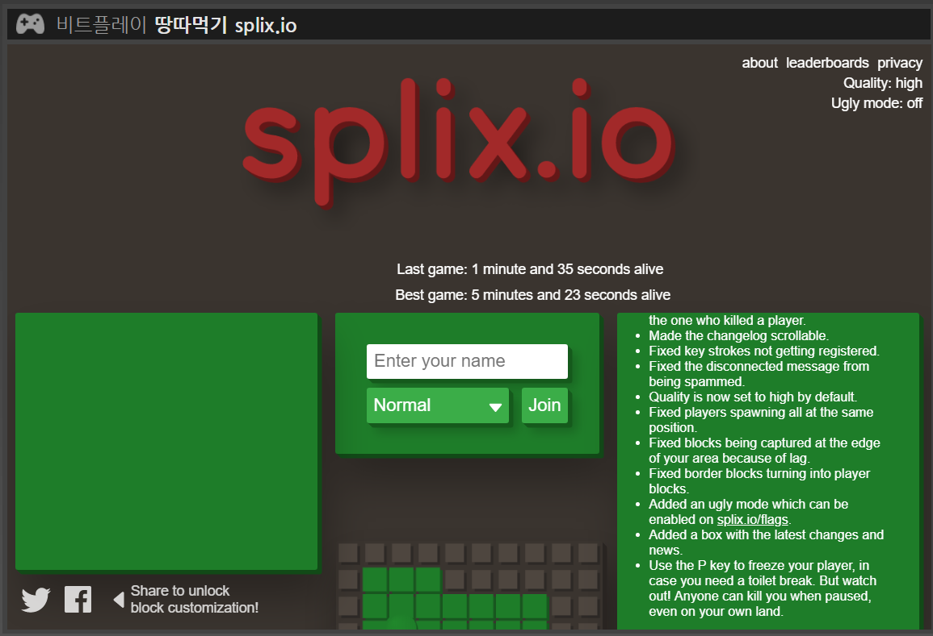
Model 1
http://bitplay.co/splixio/

Slide 4
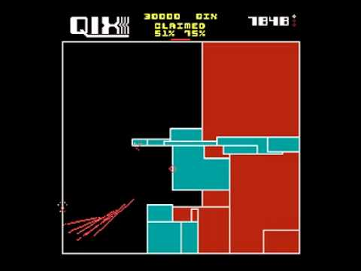
Model 2

Slide 5
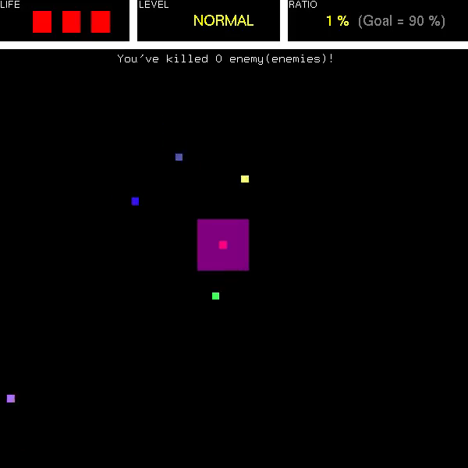
Project Demo

Slide 6
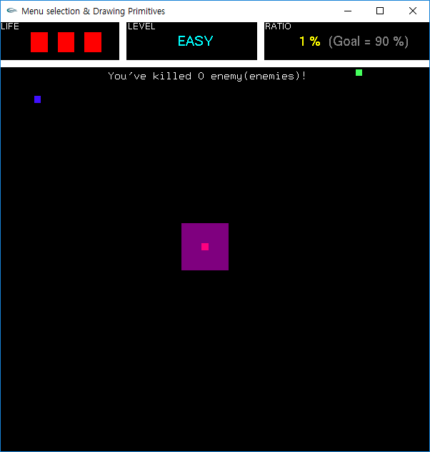
Specification
Start condition
The player has its own area.
Zombies are positioned at random location.

Slide 7
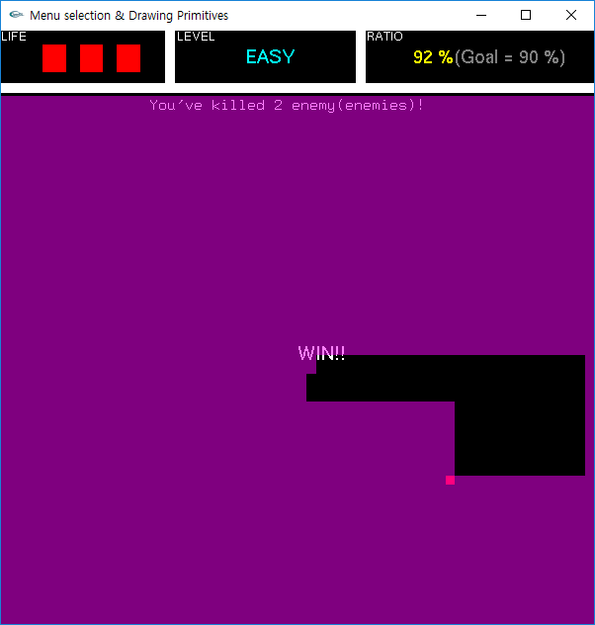
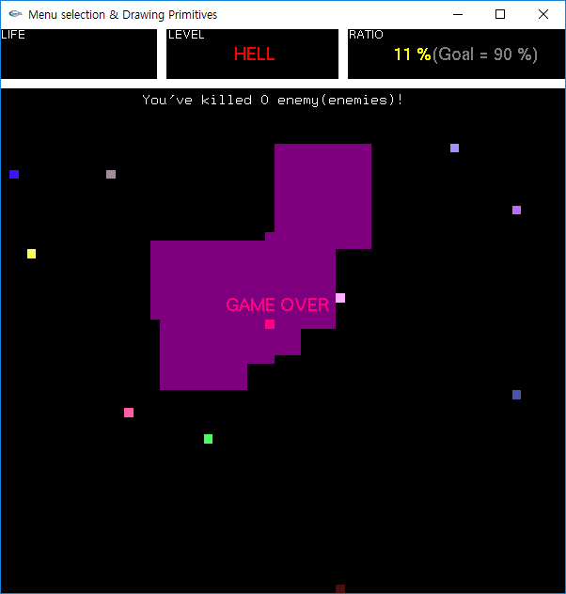
Specification
End condition
Win condition
When the player occupies over 70% of area.
Dying condition
The player is dead if zombie’s path intersects with the player or player’s trace.
The player is dead if the player intersects with its own trace.
Defeat condition
When the player is dead three times.

Slide 8
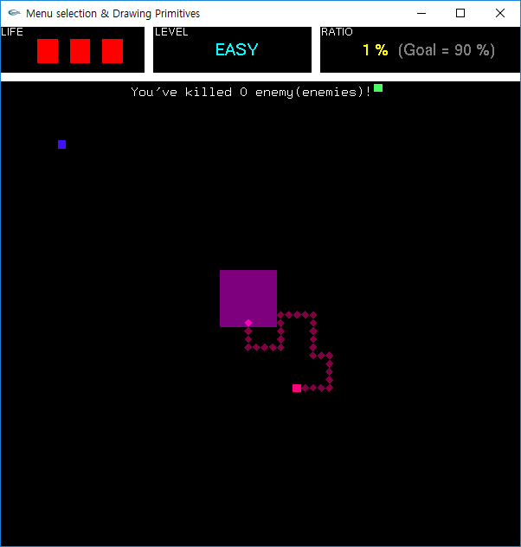
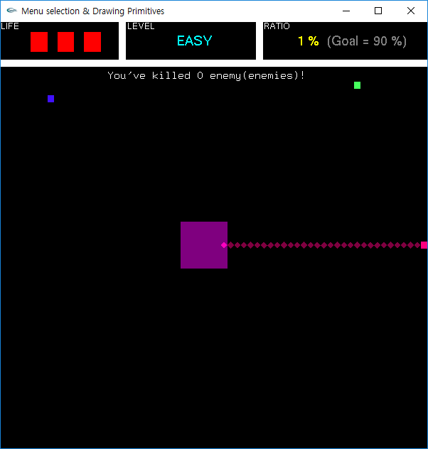
Specification
Play
Player and zombies can move up, down, left, rightward with constant speed.
Player and zombies cannot move out of map.
1
2

Slide 9
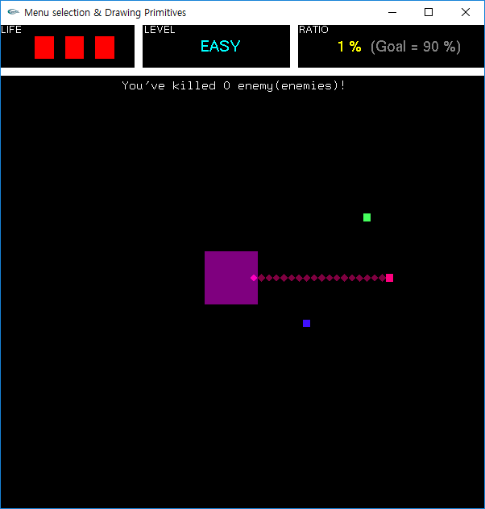

Specification
Play
The player cannot retreat.
Zombies cannot go into player’s territory.
3
4

Slide 10
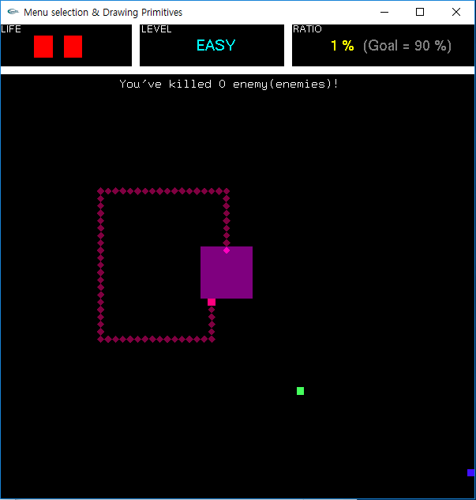
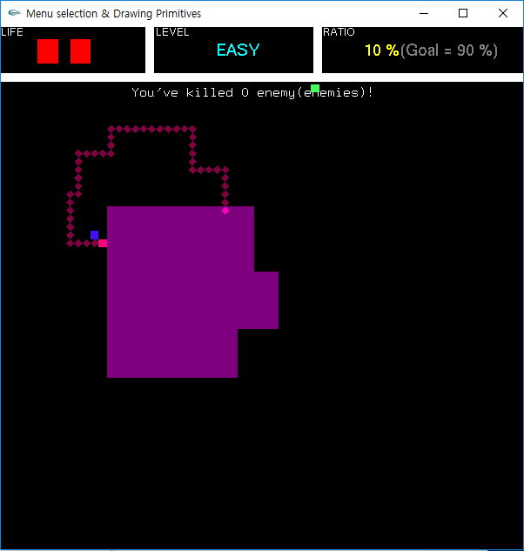
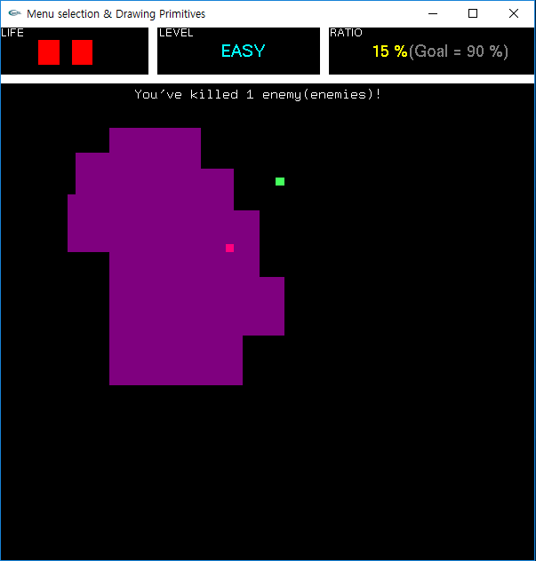
Specification
Play
If the player’s trace safely comes back, the territory is updated with as such.
If player occupies new area and a zombie is locked inside, it is dead thus eliminated.
5
6

Slide 11
Specification
Display
Player
Zombies
Player’s trace and area
Occupation ratio
Win or defeat messages

Slide 12











Converting screen coordinate
Before
After
$$(−1, 1)$$
$$(1, 1)$$
$$(0, h)$$
$$(w, h)$$
$$(x, y)$$
$$(x^{′},y^{′})$$
$$x^{′}=\frac{x}{w/2}−1$$
$$y^{′}=−\left(\frac{y}{h/2}−1\right)$$
$$(−1, −1)$$
$$(1, −1)$$
$$(0, 0)$$
$$(w, 0)$$
glMatrixMode(GL_PROJECTION);
glLoadIdentity();
gluOrtho2D(0, w, 0, h)

Slide 13




Grid
$$(0, h)$$
$$(w, h)$$
$$(0, 0)$$
$$(w, 0)$$

Slide 14
Boundary check
Initial boundary

Slide 15
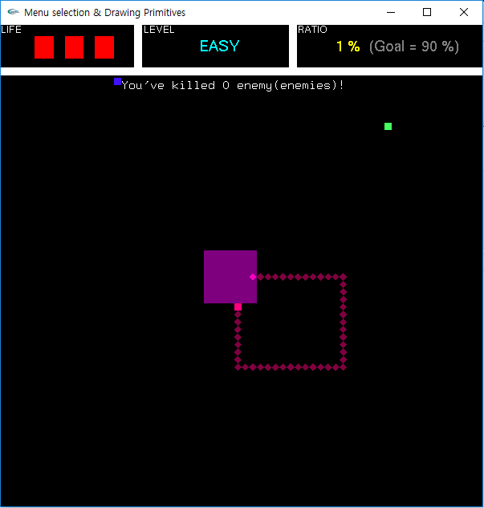
Boundary check

Slide 16
Boundary check
18
19
20
17
1
2
3
4
16
15
5
14
6
13
7
12
11
10
9
8

Slide 17
Flood fill (= Seed fill)
Flood-fill (노드, 목표 색상, 대체 색상):
노드의 색이 목표 색상과 같으면 종료
노드의 색을 대체 색상으로 변경
Flood-fill(노드의 왼쪽, 목표 색상, 대체 색상) 수행 Flood-fill(노드의 오른쪽, 목표 색상, 대체 색상) 수행 Flood-fill(노드의 위쪽, 목표 색상, 대체 색상) 수행 Flood-fill(노드의 아래쪽, 목표 색상, 대체 색상) 수행
종료

